Slide 1
SPATIAL FILTERING and ITS APPLICATIONS

Slide 2
How do we choose the elements of a mask?
Typically, by sampling certain functions.
1st derivative
of Gaussian
2nd derivative
of Gaussian
Gaussian

Slide 3
Smoothing (i.e., low-pass filters)
Reduce noise and eliminate small details.
The elements of the mask must be positive.
Sum of mask elements is 1 (after normalization)
Gaussian

Slide 4
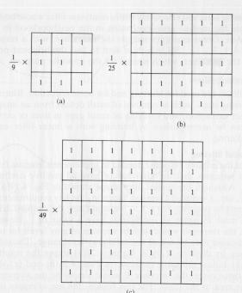
Smoothing Filters: Averaging(Low-pass filtering)

Slide 5
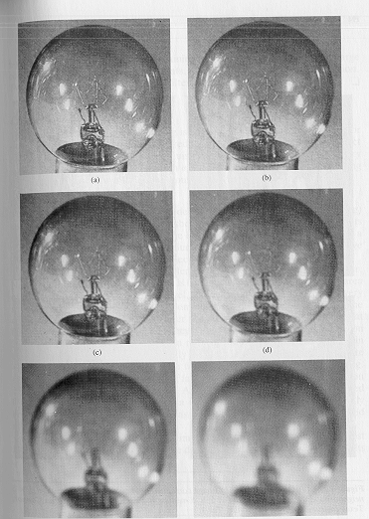
Smoothing Filters: Averaging(Low-pass filtering)
Mask size determines the degree of smoothing and loss of detail.
original
3x3
5x5
7x7
15x15
25x25

Slide 6
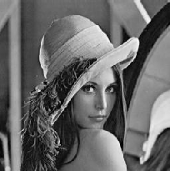
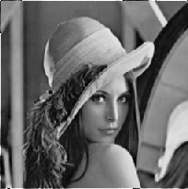
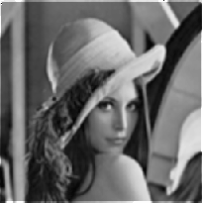

Smoothing Filters: Averaging(Low-pass filtering)
Original Image
[3x3]
[5x5]
[7x7]

Slide 7
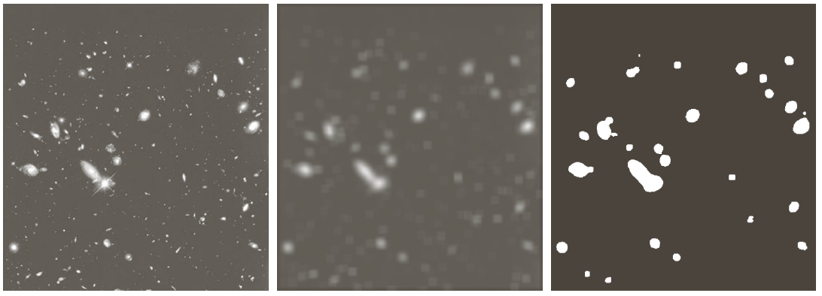
Image Enhancement in the Spatial Domain
Example: extract, largest, brightest objects
15 x 15 averaging
image thresholding

Slide 8
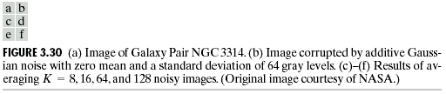
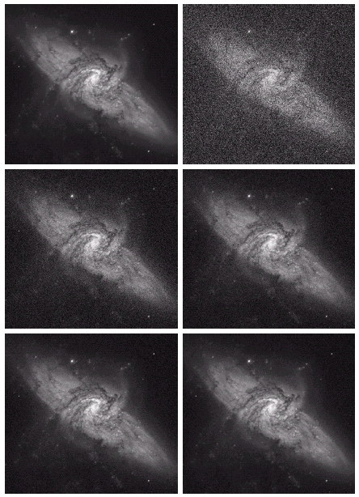

Slide 9
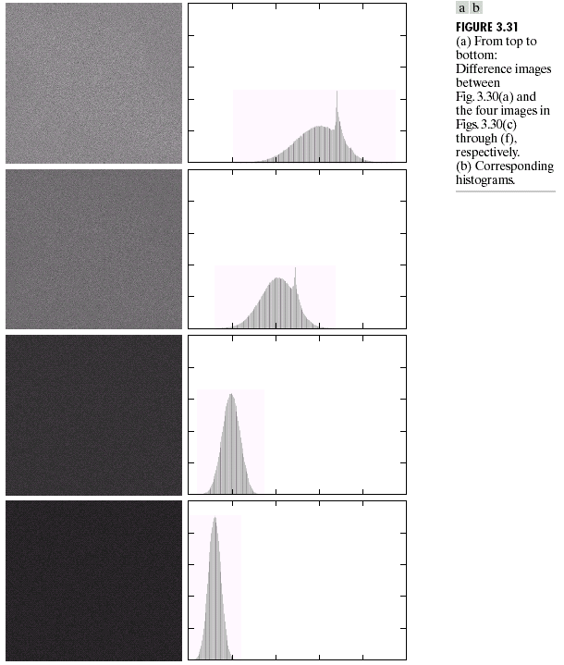
Image Enhancement in the Spatial Domain

Slide 10
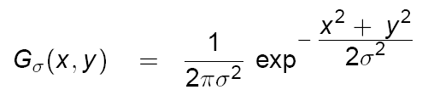
Smoothing Filters: Gaussian(Low-pass filtering)
The weights are samples of the Gaussian function
σ = 1.4
mask size is
a function of σ :

Slide 11
Smoothing Filters: Gaussian(Low-pass filtering)
σ controls the amount of smoothing
As σ increases, more samples must be obtained to represent the Gaussian function accurately.
σ = 3

Slide 12
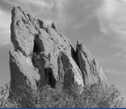
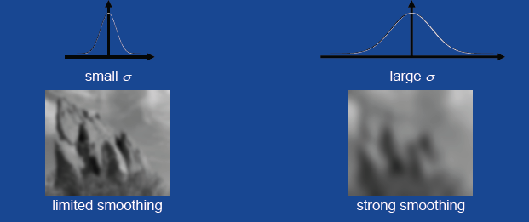
Smoothing Filters: Gaussian(Low-pass filtering)

Slide 13
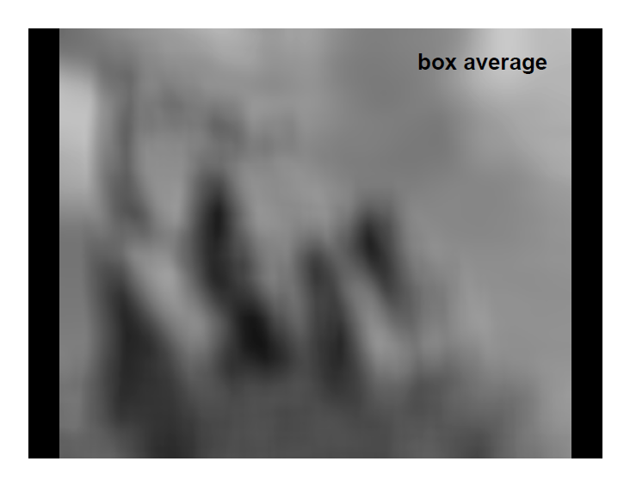
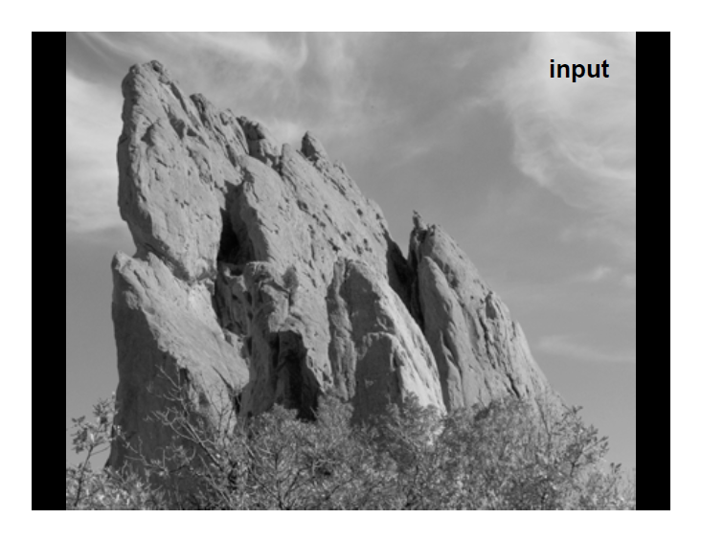
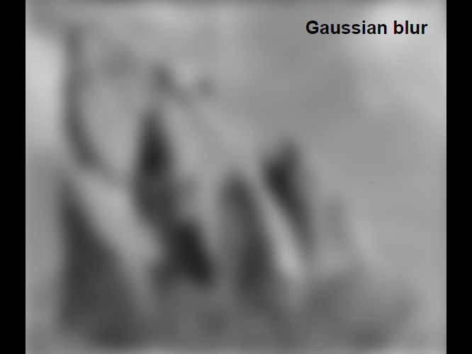
Smoothing Filters:Averaging Vs Gaussian
Averaging
Gaussian

Slide 14
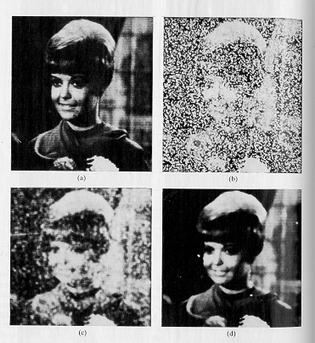
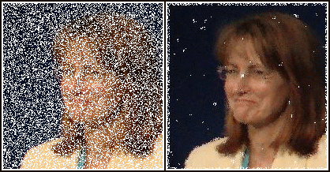
Smoothing Filters : Median
Very effective for removing “salt and pepper” noise (i.e., random occurrences of black and white pixels).
median
filtering
averaging

Slide 15
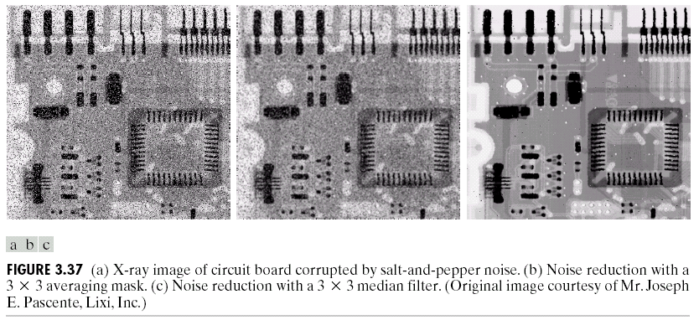
Smoothing Filters : Median
Very effective for removing “salt and pepper” noise (i.e., random occurrences of black and white pixels).

Slide 16
Neighborhood Processing : 2D filtering Noise
Types of noise:
Salt and pepper noise
Impulse noise
Gaussian noise
Due to
transmission errors
dead CCD pixels
specks on lens
can be specific to a sensor

Slide 17
NOISE TYPES

Slide 18
Effect of mean filters
3x3
5x5
7x7
Salt & Pepper noise
Gaussian noise
Side effect - blur

Slide 19
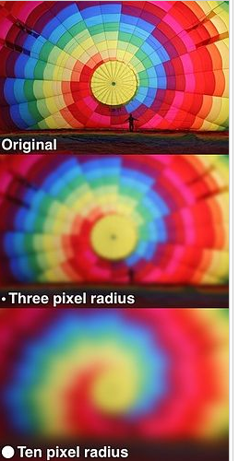
Gaussian filtering
Low-pass filter
Smooth color variation (low frequency) is preserved
Sharp edges (high frequency) are removed

Slide 20
Mean vs. Gaussian filtering

Slide 21
Smoothing Filters : Median
Salt&PepperNoise

Slide 22
Smoothing Filters : Median
Gaussian noise

Slide 23
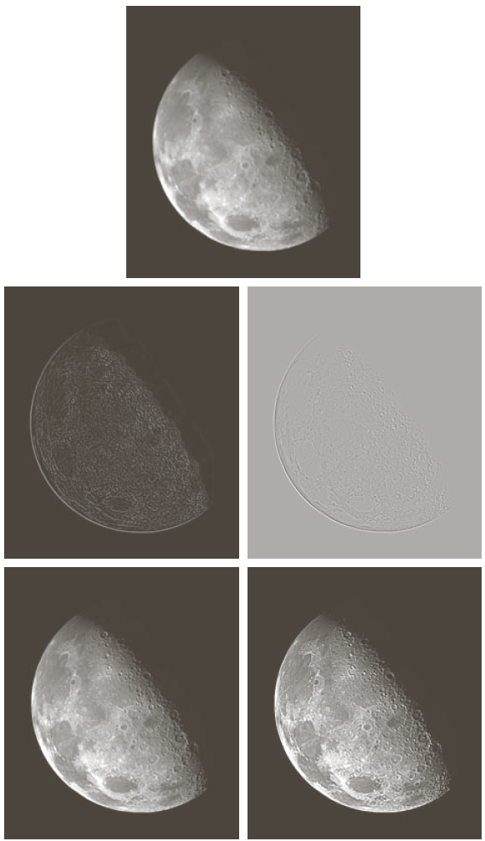
Sharpening Filters High Pass filtering
Useful for emphasizing transitions in image intensity (e.g., edges).
Note that the response of high-pass filtering might be negative. Values must be re-mapped to [0, 255]
original image
sharpened images

Slide 24



Sharpening Filters: Unsharp Masking
Obtain a sharp image by subtracting a lowpass filtered (i.e., smoothed) image from the original image:
-
=

Slide 25
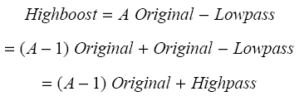

Sharpening Filters: High Boost
Image sharpening emphasizes edges but details (i.e., low frequency components) might be lost.
High boost filter: amplify input image, then subtract a lowpass image.
(A-1)
+
=

Slide 26
Sharpening Filters: High Boost
If A=1, we get a high pass filter
If A>1, part of the original image is added back to the high pass filtered image.

Slide 27

Sharpening Filters: High Boost
A=1.4
A=1.9

Slide 28
Sharpening Filters: Derivatives
A=1.4
A=1.9

Slide 29
Sharpening Filters: Derivatives
Taking the derivative of an image results in sharpening the image.
The derivative of an image can be computed using the gradient.
The gradient is a vector which has Magnitude and Direction:
Δf
or
(approximation)

Slide 30
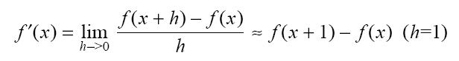
Sharpening Filters: Derivatives
Magnitude: provides information about edge strength.
Direction: perpendicular to the direction of the edge.
sensitive to vertical edges
Δx
sensitive to horizontal edges

Slide 31
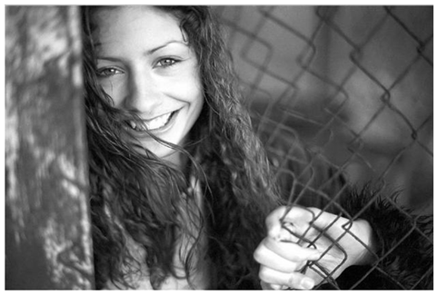
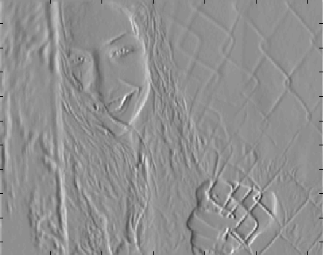
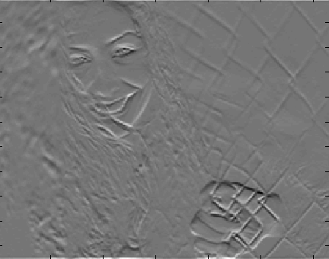
Sharpening Filters: Derivatives
sensitive to vertical edges
sensitive to horizontal edges

Slide 32
Sharpening Filters: Derivatives
(x+1/2,y)
good approximation
(x+1/2,y+1/2)
(x,y+1/2)
*
*
*
Sobel

Slide 33
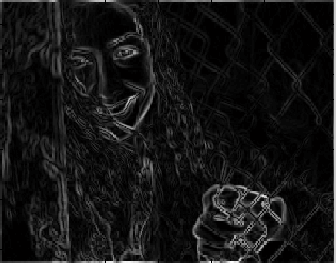
Sharpening Filters: Derivatives

Slide 34
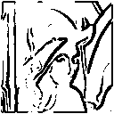
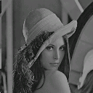
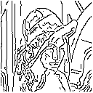
Image Gradient for Edge Detection
Typical application where image gradients are used is image edge detection
find points with large image gradients
Canny edge detector suppresses
non-extrema Gradient points

Slide 35
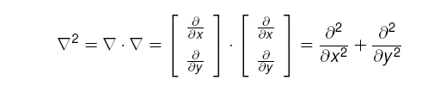
Sharpening Filters: Laplacian
The Laplacian (2nd derivative) is defined as:
(dot product)
Approximate
derivatives:

Slide 36
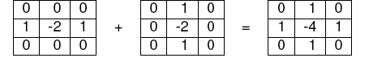
Sharpening Filters: Laplacian
Laplacian Mask
detect zero-crossings

Slide 37
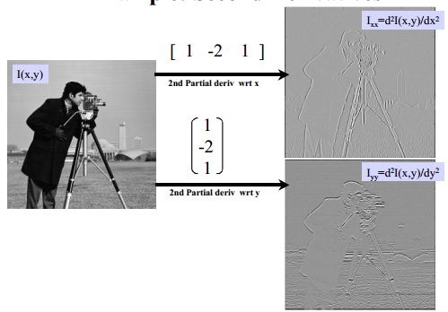
Sharpening Filters: Laplacian

Slide 38
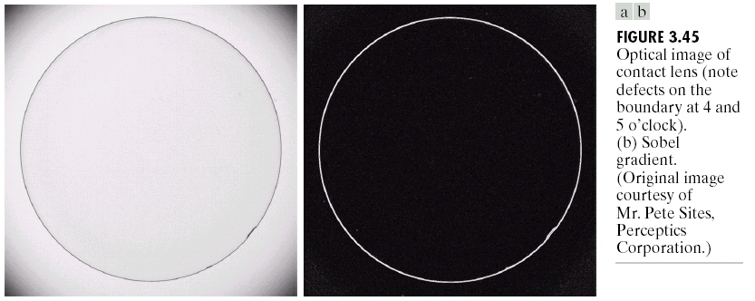
Sobel Filter for Edge Detection:Example
An image of a contact lens which is enhanced in order to make defects (at four and five o’clock in the image) more obvious
-1
-2
-1
-1
0
1
0
0
0
-2
0
2
1
2
1
-1
0
1

Slide 39
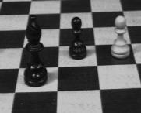
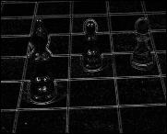
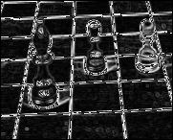
Sharpening Filters: Laplacian
Laplacian
Sobel

Slide 40
Sharpening Filters: Laplacian
1st order derivatives produce thicker edges in an image
2nd order derivatives have stronger response to fine detail
1st order derivatives have stronger response to a gray lever step
2nd order derivatives produce a double response at step changes in gray level
Better localized edges
But more sensitive to noise

Slide 41
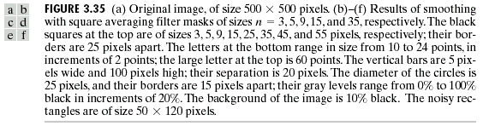
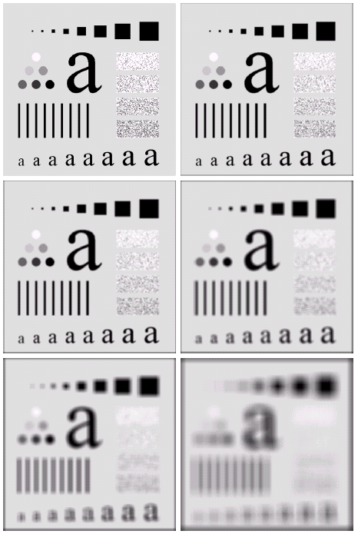
Figures in sequence
a
b c d e f

Slide 42
Local Enhancement
When it is necessary to enhance details over smaller areas
Devise transformation functions based on the gray-level distribution in the neighborhood of every pixel
The procedure
Define a square (or rectangular) neighborhood and move the center of this area from pixel to pixel.
At each location, the histogram of the points in the neighborhood is computed and either a histogram equalization or histogram specification transformation function is obtained.
This function is finally used to map the gray level of the pixel centered in the neighborhood.
The center is then moved to an adjacent pixel location and the procedure is repeated.

Slide 43
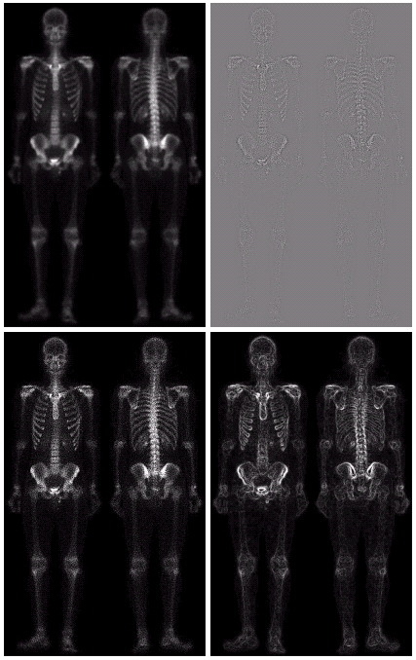
Combining Spatial Enhancement Methods
(a)
Laplacian filter of bone scan (a)
(b)
Sharpened version of bone scan achieved by subtracting (a) and (b)
(c)
Sobel filter of bone scan (a)
(d)

Slide 44
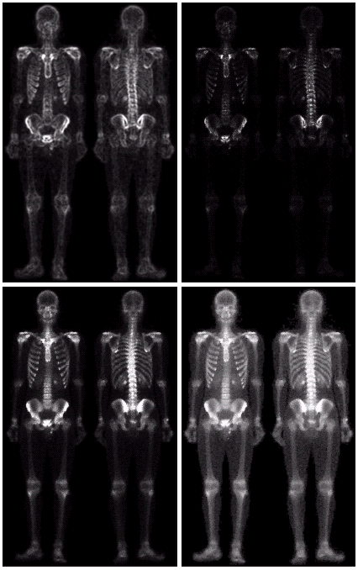
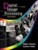
Combining Spatial Enhancement Methods
Result of applying a power-law trans. to (g)
Sharpened image which is sum of (a) and (f)
The product of (c) and (e) which will be used as a mask
(g)
(f)
(e)
Images taken from Gonzalez & Woods, Digital Image Processing (2002)
Image (d) smoothed with a 5*5 averaging filter

Slide 45
Combining Spatial Enhancement Methods
Compare the original and final images
Images taken from Gonzalez & Woods, Digital Image Processing (2002)

Slide 46
END

